Slide 1

INDUSTRIAL UNIVERSITY OF HO CHI MINH CITY
FACULTY OF INFOMATION TECHNOLOGY
Graduation Thesis
Topic:
GearVM Electronic Equipment Sales Management System
Specialized training:
Instructor:
Students perform 1:
Students perform 2:
Software Engineer
PhD. Nguyen Thi Hoang Khanh
Giang Vu Hoang Tuan – MSSV: 19490911
Tran Hoang Long – MSSV: 19493061

Slide 2


MAIN CONTENT
2. Purpose
4. Construction process
1. Problem statement
3. Overview
5. Conclude

Slide 3
1. Problem statement
Information technology is constantly evolving
Satisfying human shopping needs.
Enterprise information management
Applying "Information Technology" in the management of electronic equipment sales Gearvm

Slide 4
2. Purpose
Build gearvm electronic equipment sales management system
Building and designing an electronic equipment sales system
Manage system information
Apply knowledge learned in school
Meet the actual needs of today

Slide 5
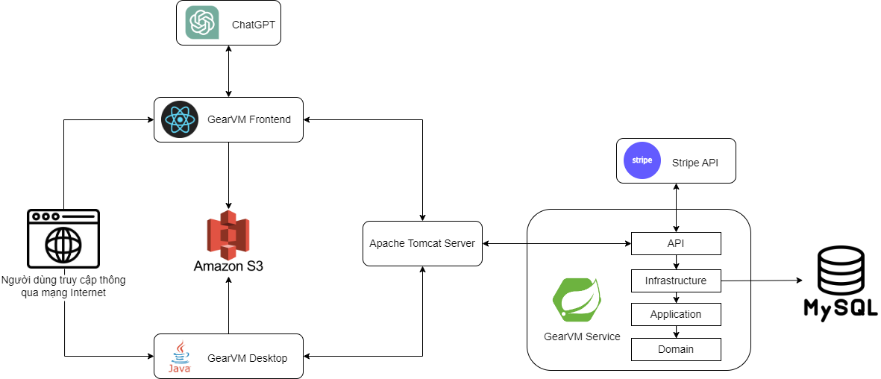
3. Overview

Slide 6














3. Overview
Backend
Frontend

Slide 7
4. Construction process
Analysis of business requirements
System design
Realize the system's functionality
System Testing
System deployment

Slide 8
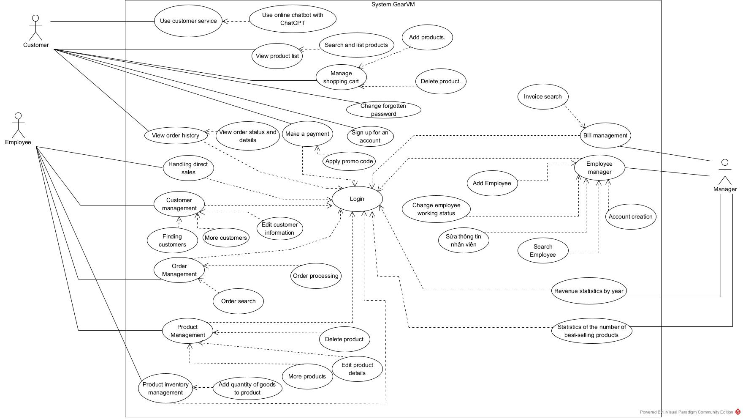
Use Case Diagram

Slide 9
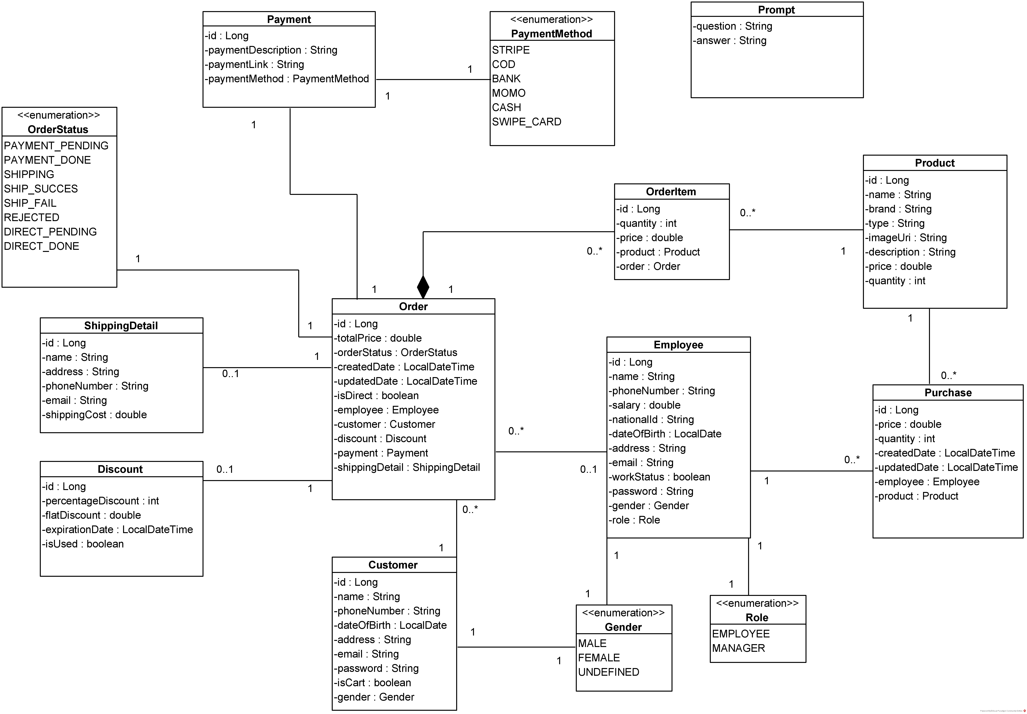
Class Diagram

Slide 10
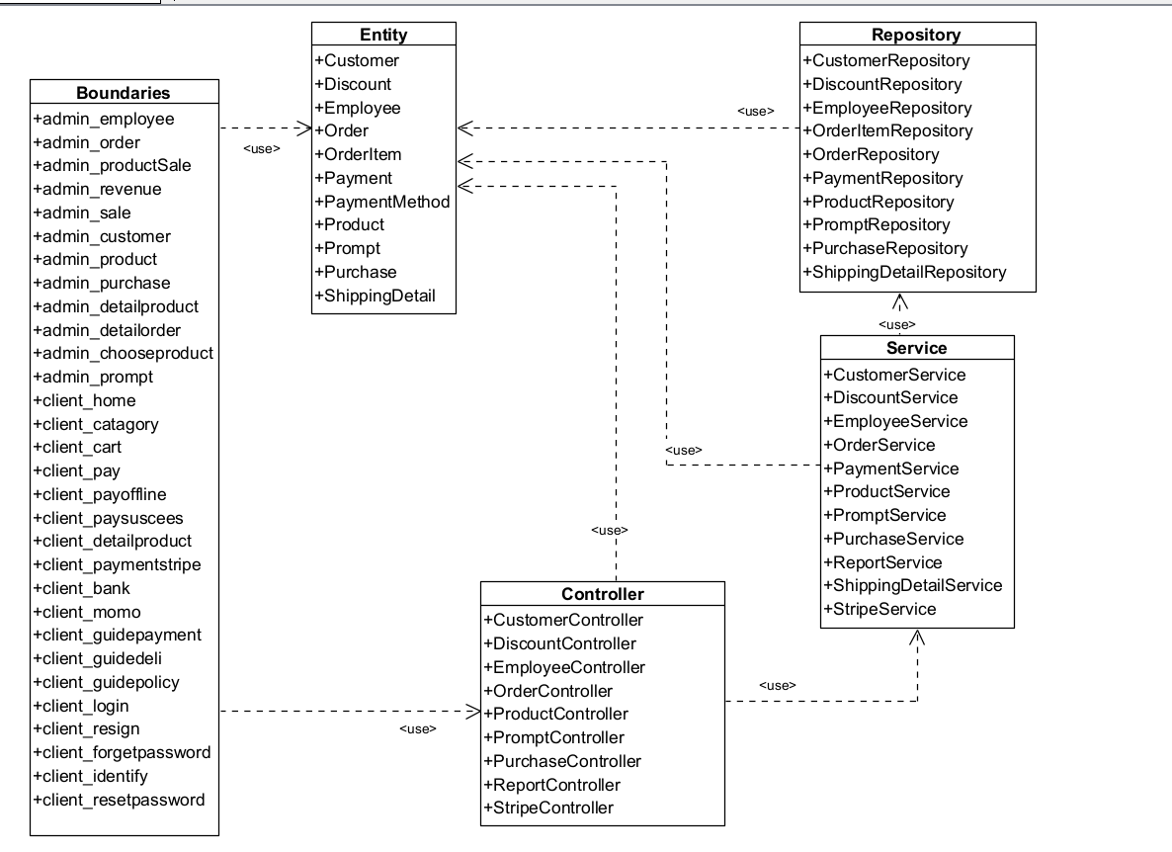
Overall Class Diagram

Slide 11
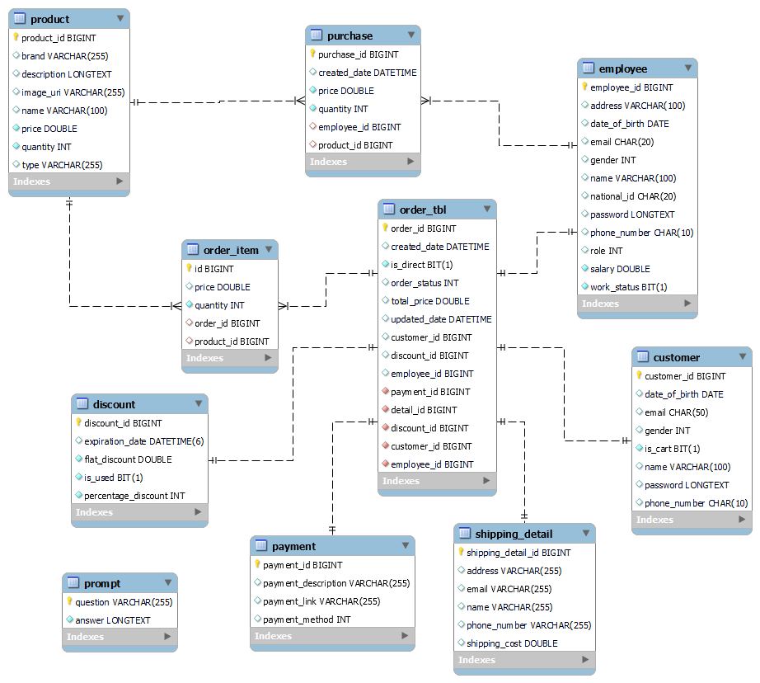
ER Diagram

Slide 12
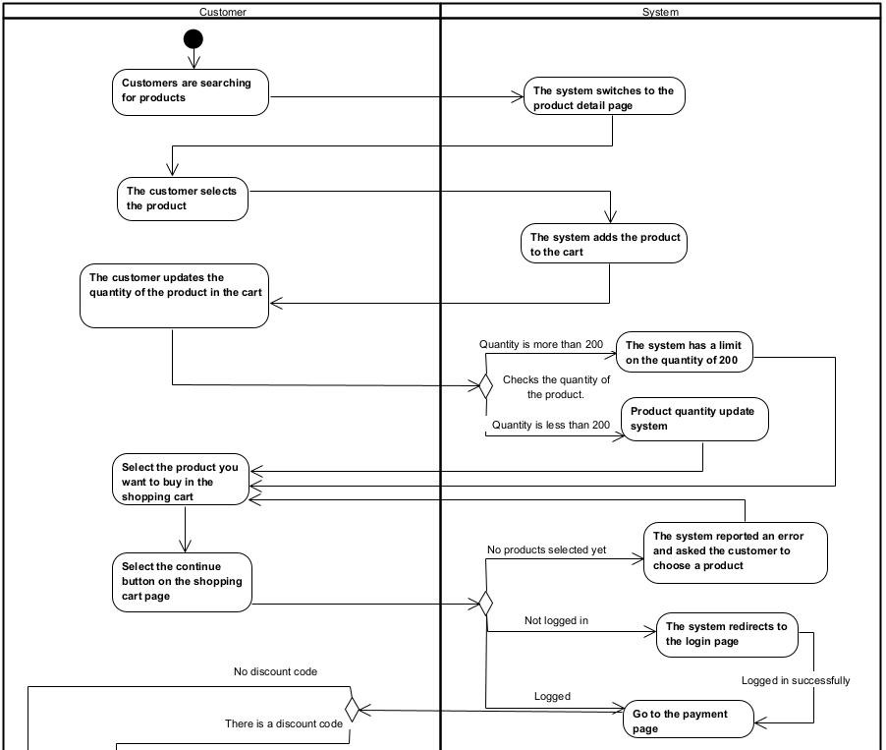
Activity diagram for Ordering

Slide 13
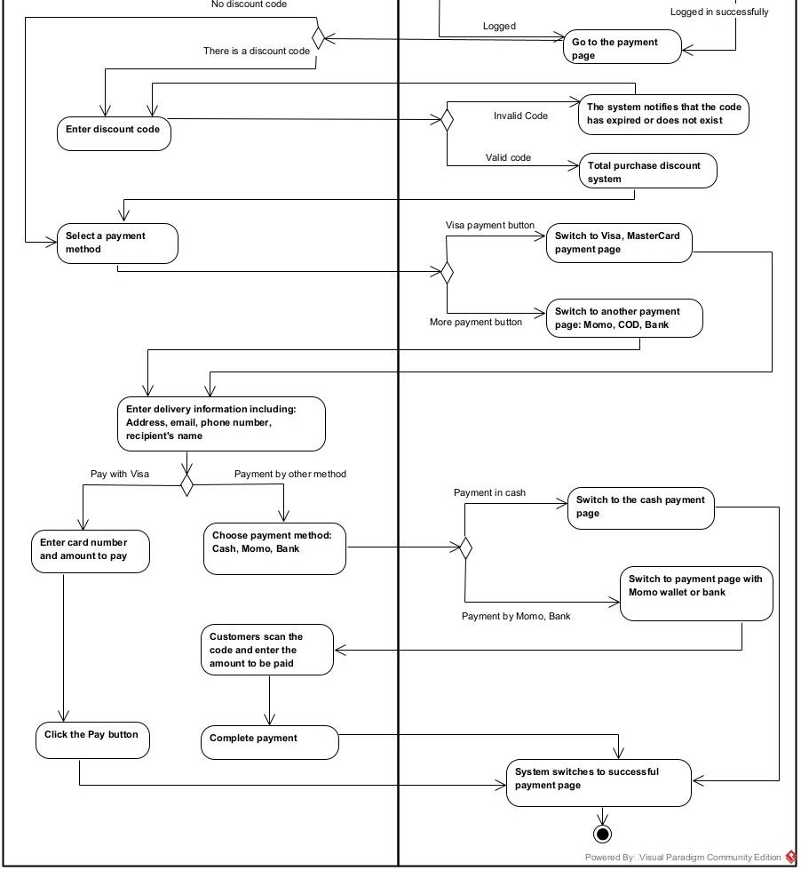

Slide 14
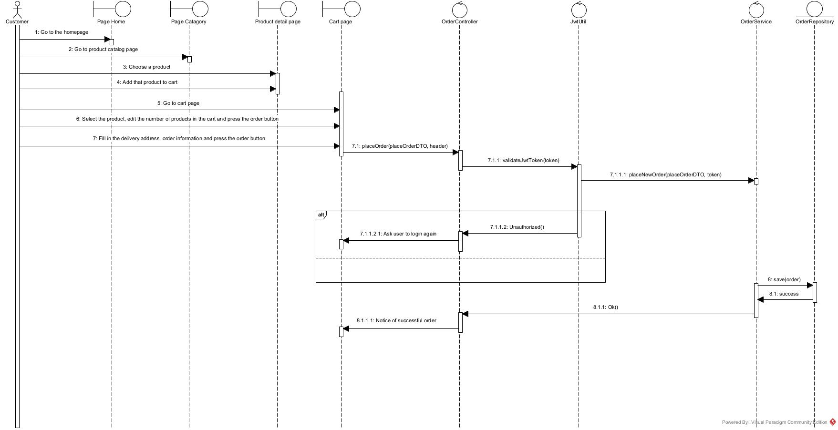
Sequence Diagram for Ordering

Slide 15
5. Conclude
Achieved results
Limitations
Using new and modern technologies such as ChatGPT, AWS S3, etc.
The software has the ability to be implemented in practical use cases.
The source code allocation has not been optimized.
Development directions
Continuously upgrading with more useful features.
Continuously researching and applying microservice models for the next project.

Slide 16
THANK YOU FOR LISTENING!
Q&A

